Slide 1



Hardware and Software Fundamentals of
Intelligent Computing
Systems

Slide 2
Lecture 32: Communication Topology Optimization

Slide 3
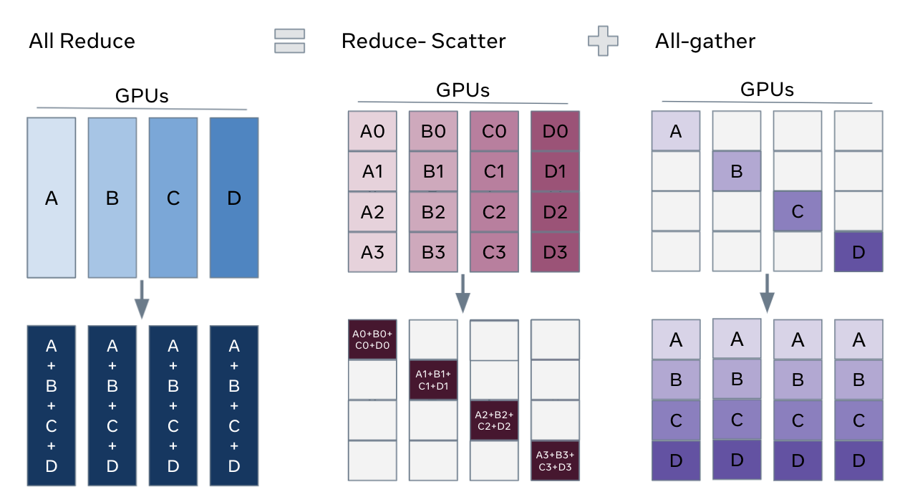
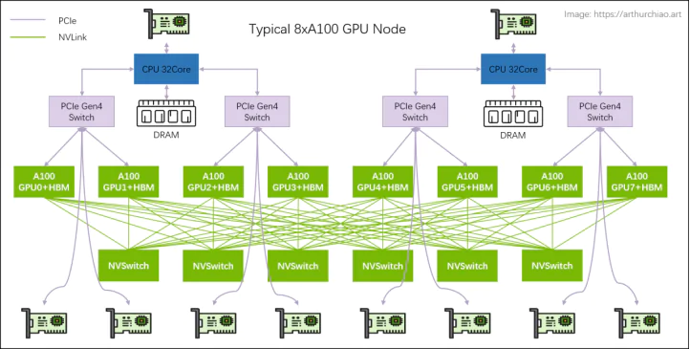
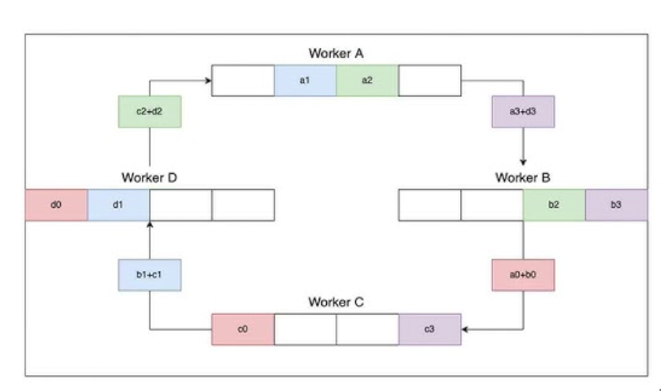
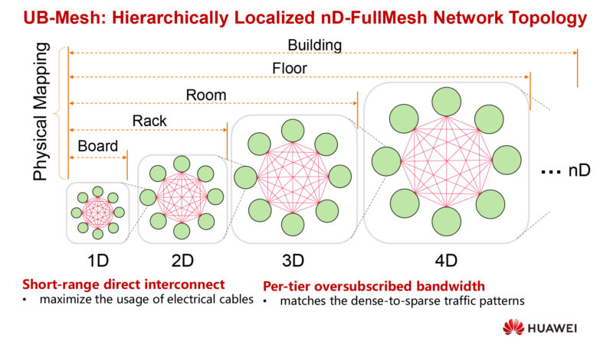
Implementations of collective communication operators
All-reduce = Reduce-scatter + all-gather
The implementations
highly depends on
the hardware topology
NVIDIA GPU CLOS Topology
Ring All-reduce
HUAWEI NPU Full-mesh Topology

Slide 4
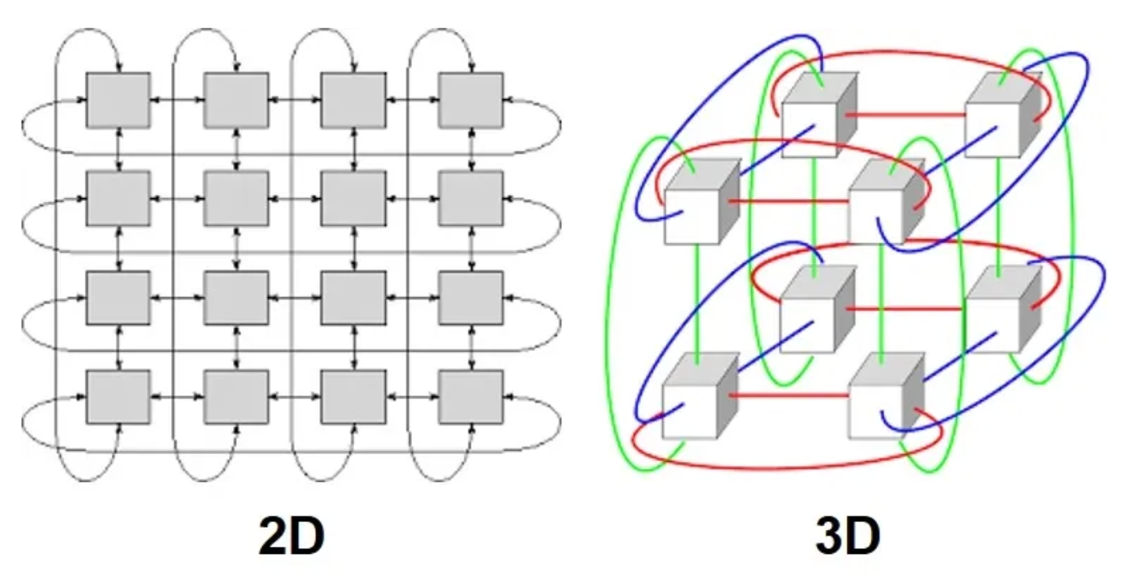
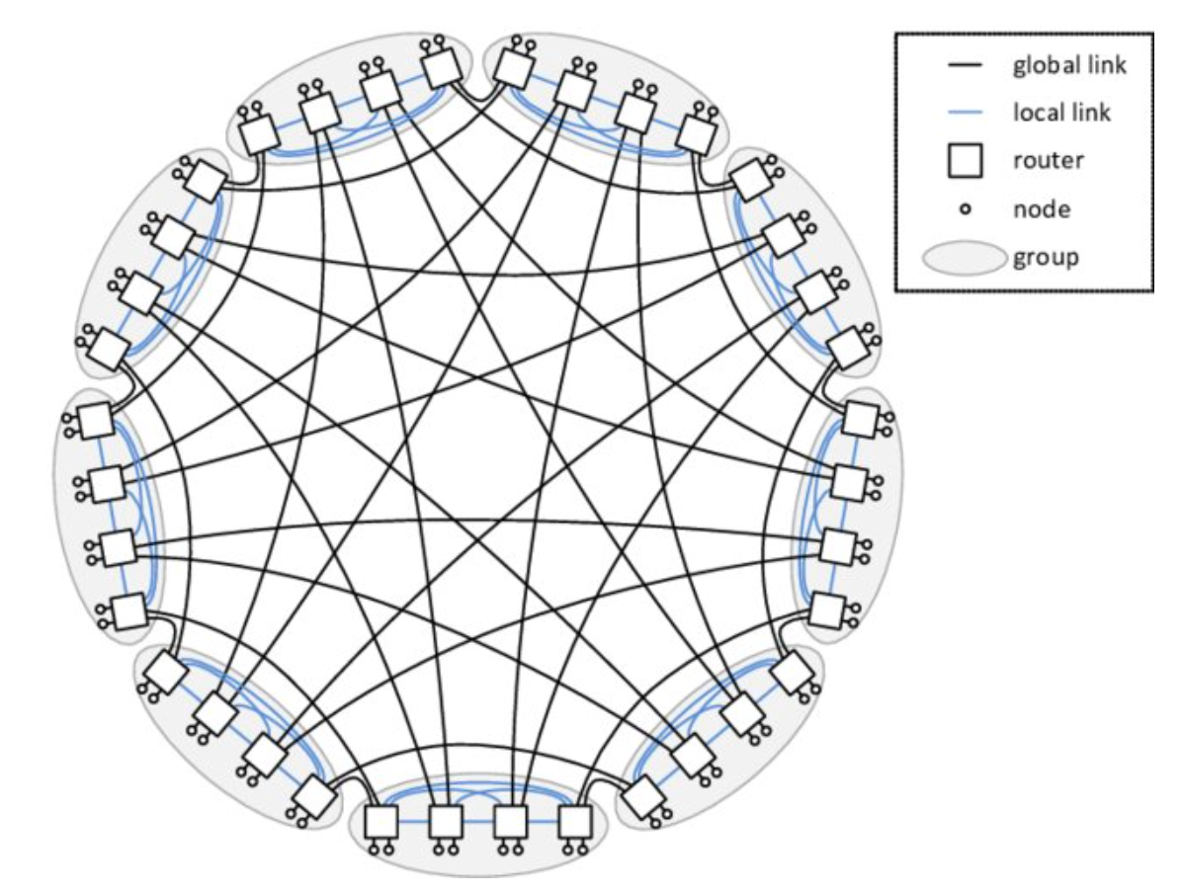
Topologies in the modern AI systems
NVIDIA GPU Clos Topology
GOOGLE TPU Torus Topology
HUAWEI NPU Full-mesh Topology
Dragonfly Topology

Slide 5
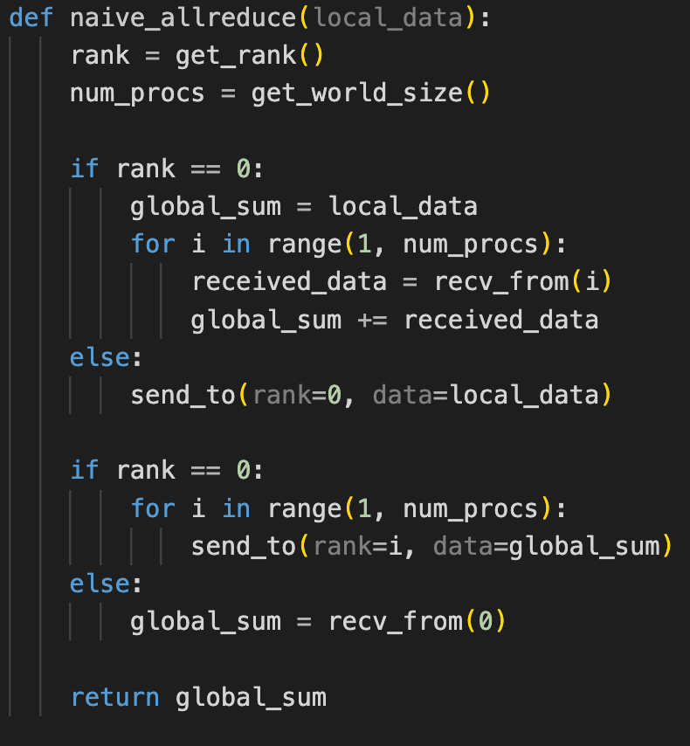
Take AllReduce as an example
Start from a naive implementation with root rank = 0.
  Data transfer volume: 2 * (N-1) * K
There are three disadvantages
  The bandwidth and computation of Rank 0 become bottleneck.
  There are many idle resources during the allreduce (Rank 1 – N-1).
  Poor scalability and lacks the consideration of topology.
How can we improve it?
  Scatter the data transfer and computation workload to all of the ranks.
Solutions:
  Tree-based, ring-based, halving-doubling, etc.

Slide 6
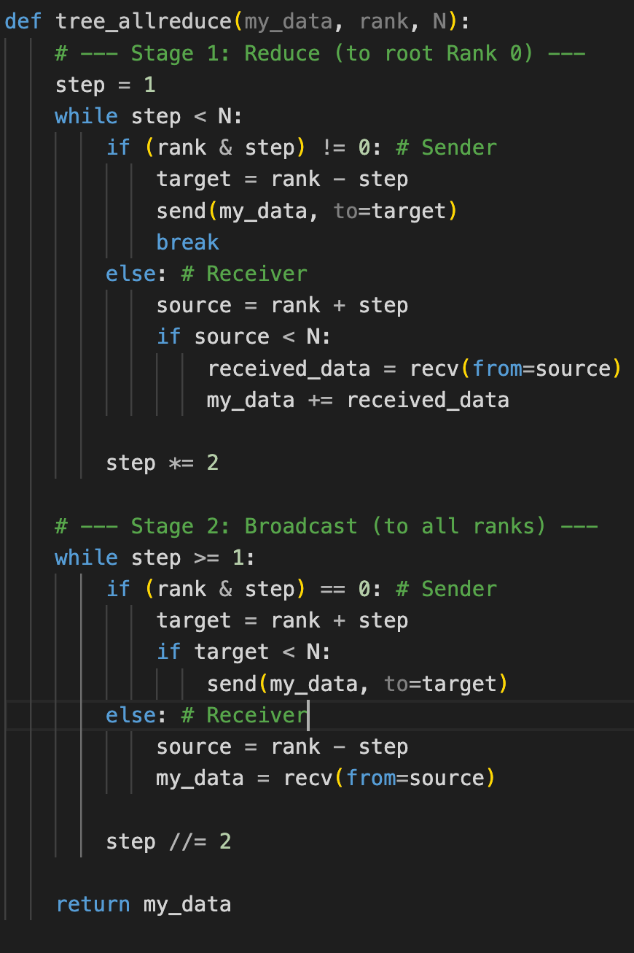
Take AllReduce as an example
Tree-based AllReduce Algorithm
  Build a hierarchical relation with the root of tree (Rank 0).
  Stage 1: Bottom-up Reduce
  Stage 2: Top-down Broadcast
Rank 0
Rank 7
0
1
2
3
4
5
6
7
0+1
1
2+3
3
4+5
5
6+7
7
S1 Reduce
0+1+2+3
1
2+3
3
4+5+6+7
5
6+7
7
SUM(0,7)
1
2+3
3
4+5+6+7
5
6+7
7

Slide 7
Take AllReduce as an example
Tree-based AllReduce Algorithm
  Build a hierarchical relation with the root of tree (Rank 0).
  Stage 1: Bottom-up Reduce
  Stage 2: Top-down Broadcast
Rank 0
Rank 7
SUM(0,7)
1
2
3
4
5
6
7
SUM(0,7)
1
2
3
SUM(0,7)
5
6
7
S2 Broadcast
SUM(0,7)
1
SUM(0,7)
3
SUM(0,7)
5
SUM(0,7)
7
SUM(0,7)
SUM(0,7)
SUM(0,7)
SUM(0,7)
SUM(0,7)
SUM(0,7)
SUM(0,7)
SUM(0,7)

Slide 8
Take AllReduce as an example
Tree-based AllReduce Algorithm
  Build a hierarchical relation with the root of tree (Rank 0).
  Stage 1: Bottom-up Reduce
  Stage 2: Top-down Broadcast
Advantages
  Parallel data transfer and reduce operations.
  Logarithmic complexity (the naive version has linear complexity).
  It excels with small data sizes because of the low latency.
Disadvantages
  It still has idle computing and bandwidth resources.
Further Opt: Double Binary Tree (NCCL)

Slide 9
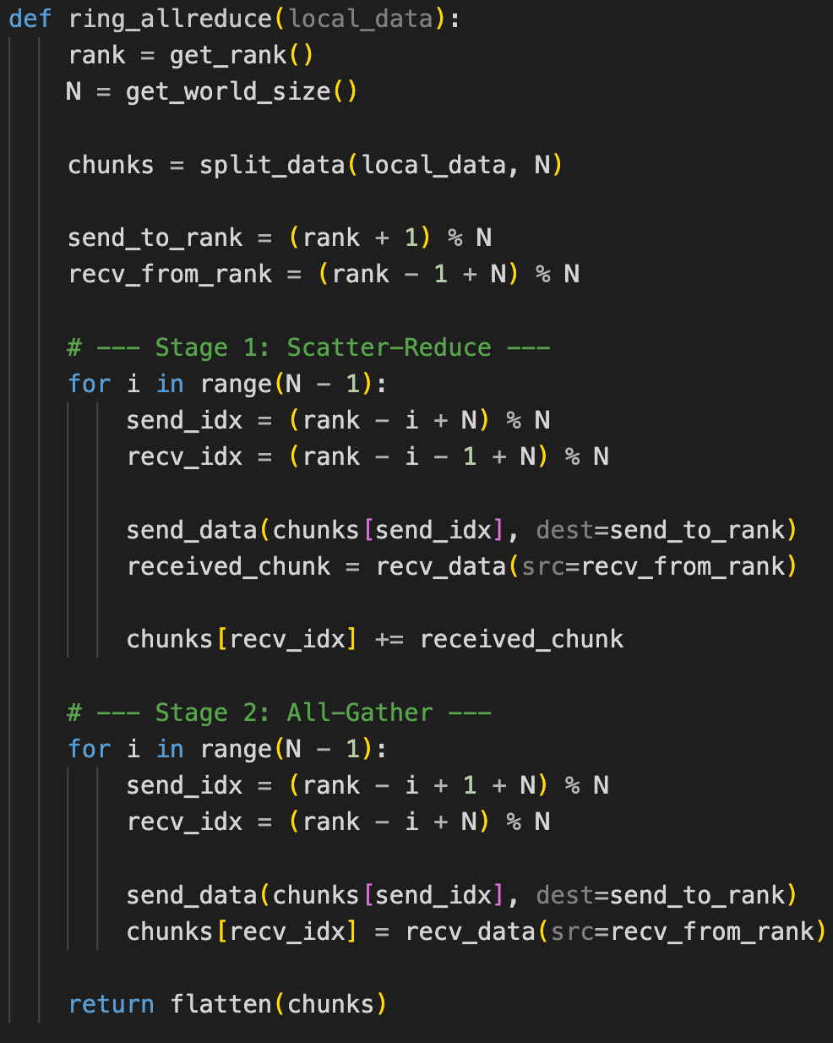
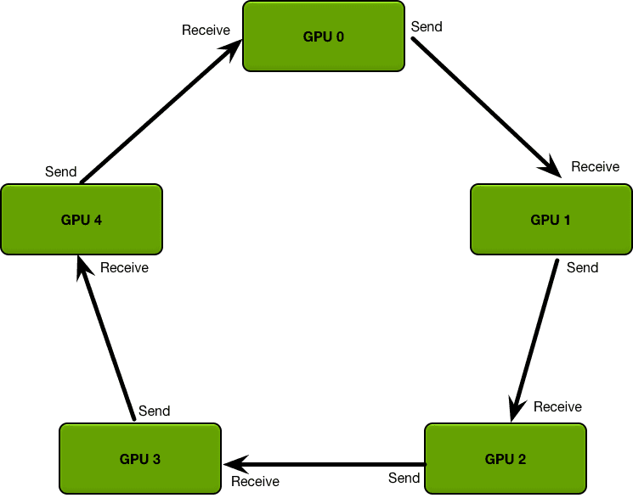
Take AllReduce as an example
Ring-based AllReduce Algorithm
  Stage 1: Iterative Reduce
  Stage 2: Iterative Gather

Slide 10
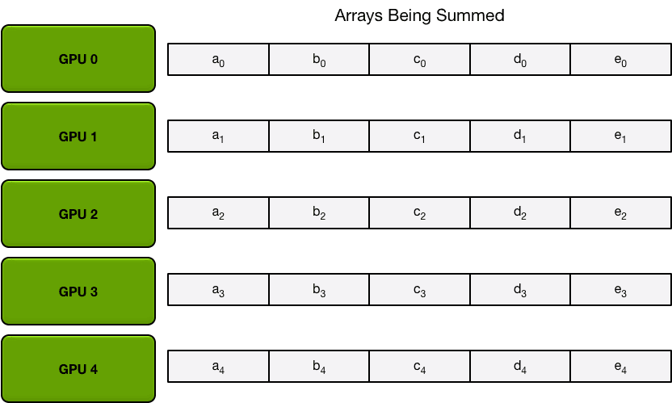
Take AllReduce as an example
Ring-based AllReduce Algorithm
  Stage 1: Iterative Reduce with N-1 steps
  Stage 2: Iterative Gather with N-1 steps
Split the data with N partitions

Slide 11
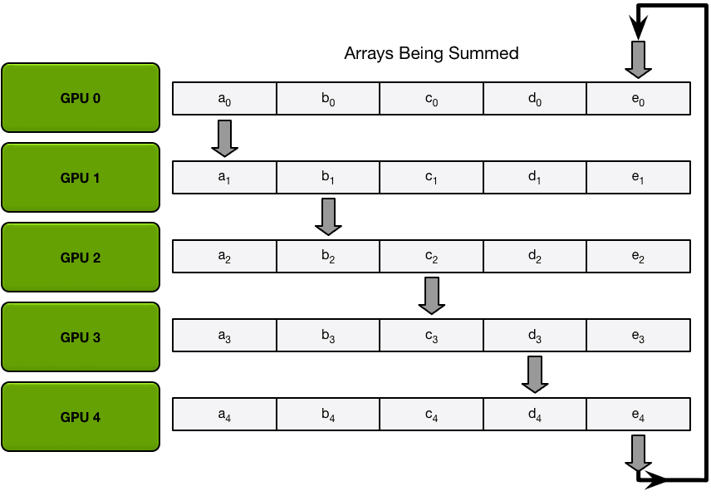
Take AllReduce as an example
Ring-based AllReduce Algorithm
  Stage 1: Iterative Reduce with N-1 steps
  Stage 2: Iterative Gather with N-1 steps

Slide 12
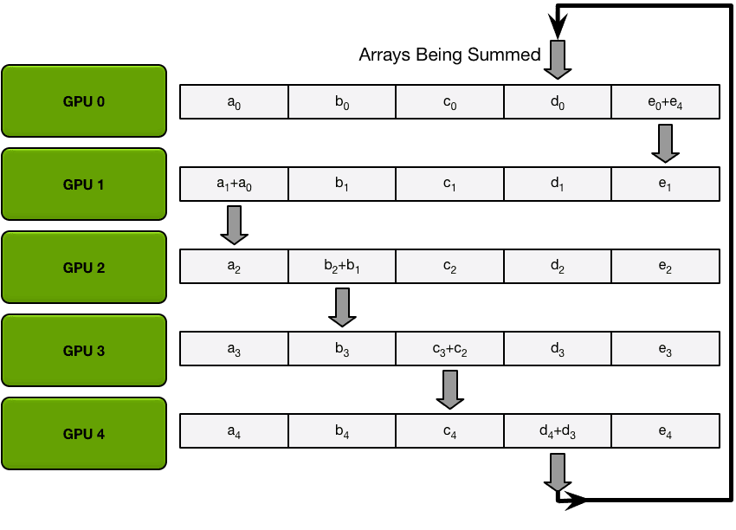
Take AllReduce as an example
Ring-based AllReduce Algorithm
  Stage 1: Iterative Reduce with N-1 steps
  Stage 2: Iterative Gather with N-1 steps

Slide 13
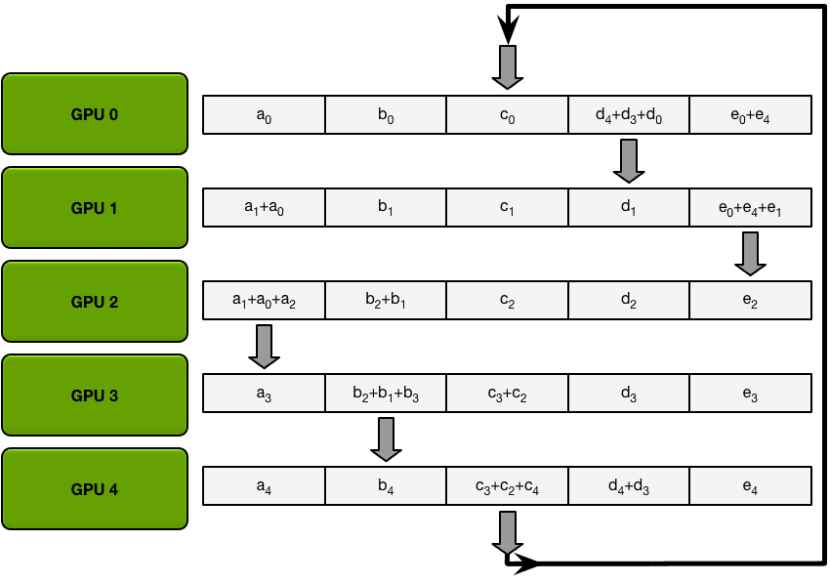
Take AllReduce as an example
Ring-based AllReduce Algorithm
  Stage 1: Iterative Reduce with N-1 steps
  Stage 2: Iterative Gather with N-1 steps

Slide 14
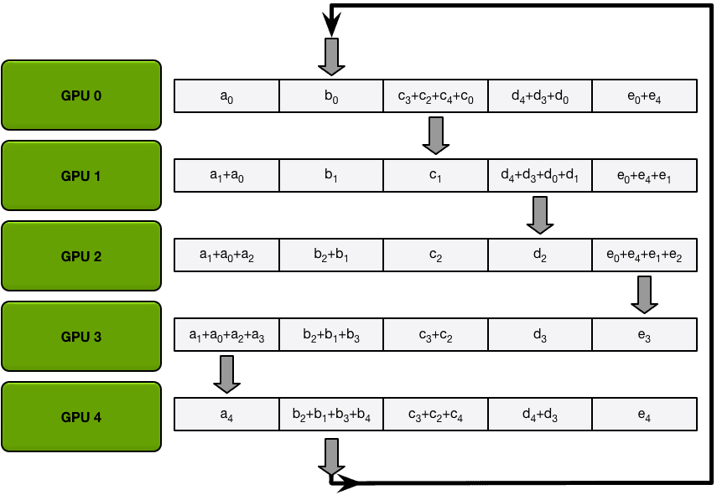
Take AllReduce as an example
Ring-based AllReduce Algorithm
  Stage 1: Iterative Reduce with N-1 steps
  Stage 2: Iterative Gather with N-1 steps

Slide 15
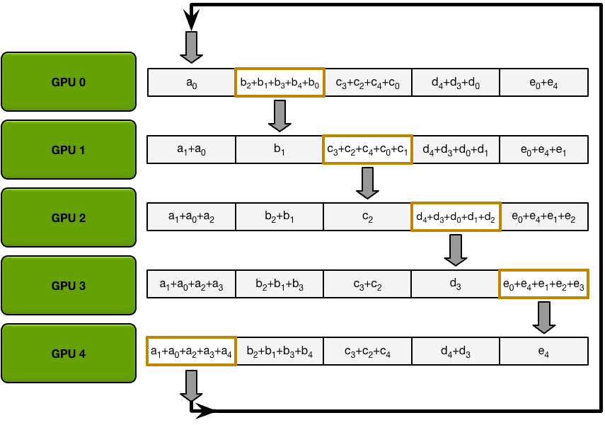
Take AllReduce as an example
Ring-based AllReduce Algorithm
  Stage 1: Iterative Reduce with N-1 steps
  Stage 2: Iterative Gather with N-1 steps

Slide 16
Take AllReduce as an example
Ring-based AllReduce Algorithm
  Stage 1: Iterative Reduce with N-1 steps
  Stage 2: Iterative Gather with N-1 steps
Quantitative Analysis
  Data Transfer Volume: 2 * (N-1) * K / N
  Overall Time: 2 * (N-1) * alpha + 2 * (N-1) * K / N / beta
  Tree-based AllReduce Time : 2 * log(N) * (alpha + K / beta)
  alpha: latency; beta: bandwidth
Advantages: Optimal bandwidth utilization

Slide 17
Take AllReduce as an example
Ring-based AllReduce Algorithm
  Stage 1: Iterative Reduce with N-1 steps
  Stage 2: Iterative Gather with N-1 steps
Quantitative Analysis
  Data Transfer Volume: 2 * (N-1) * K / N
  Overall Time: 2 * (N-1) * alpha + 2 * (N-1) * K / N / beta
  Tree-based AllReduce Time : 2 * log(N) * (alpha + K / beta)
  alpha: latency; beta: bandwidth
Advantages: Optimal bandwidth utilization

Slide 18
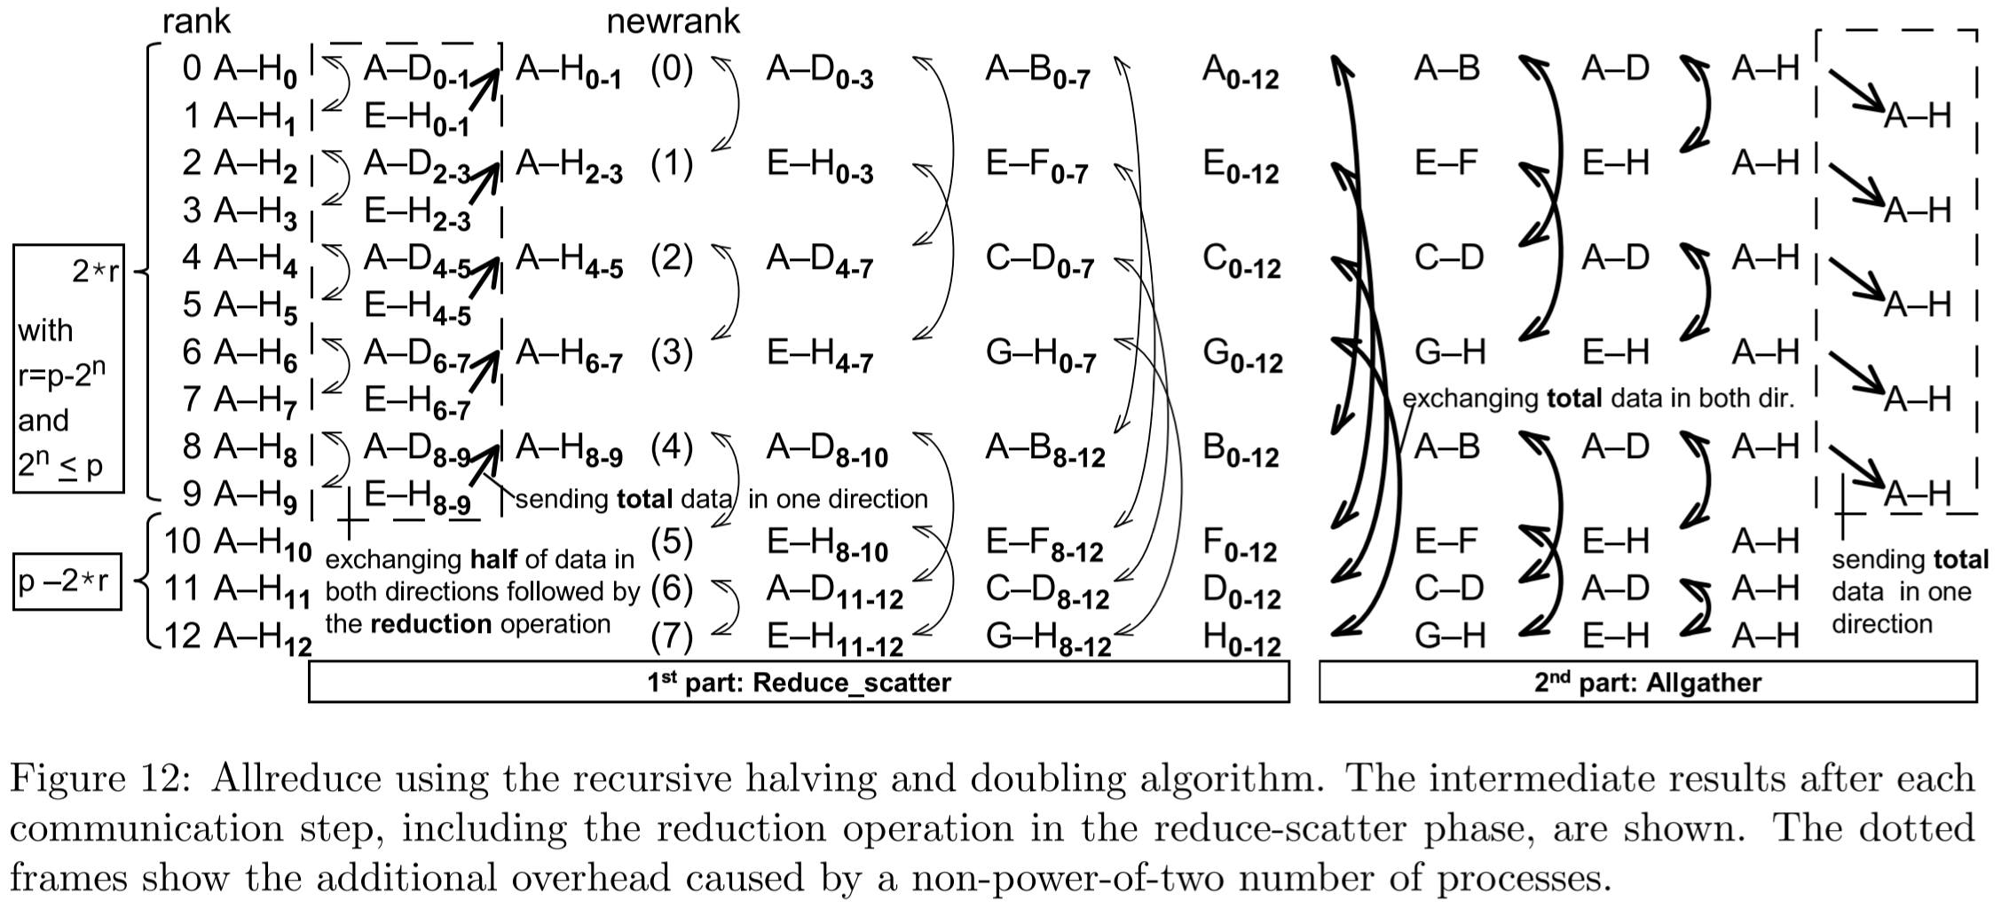
Take AllReduce as an example
Halving-doubling AllReduce Algorithm
  Stage 1: Recursive halving reduce
  Stage 2: Recursive doubling gather

Slide 19
Take AllReduce as an example
Comparisons among ring-based, tree-based, and halving-doubling Allreduce algorithms.
Modern CCLs can select an efficient strategy according to the topology and the communication domain.
Algorithm | Steps (Complexity) | Latency | Bandwidth Efficiency | Ideal Data Size
Ring-based | O(N) | High | Optimal | Large Data (> 64MB)
Tree-based | O(log N) | Lowest | Moderate | Small-Medium (< 16MB)
Halving-Doubling | O(log N) | Low | Moderate | Very Small (< 1MB)
Notes:
https://zhuanlan.zhihu.com/p/1976385706453652306

Slide 20
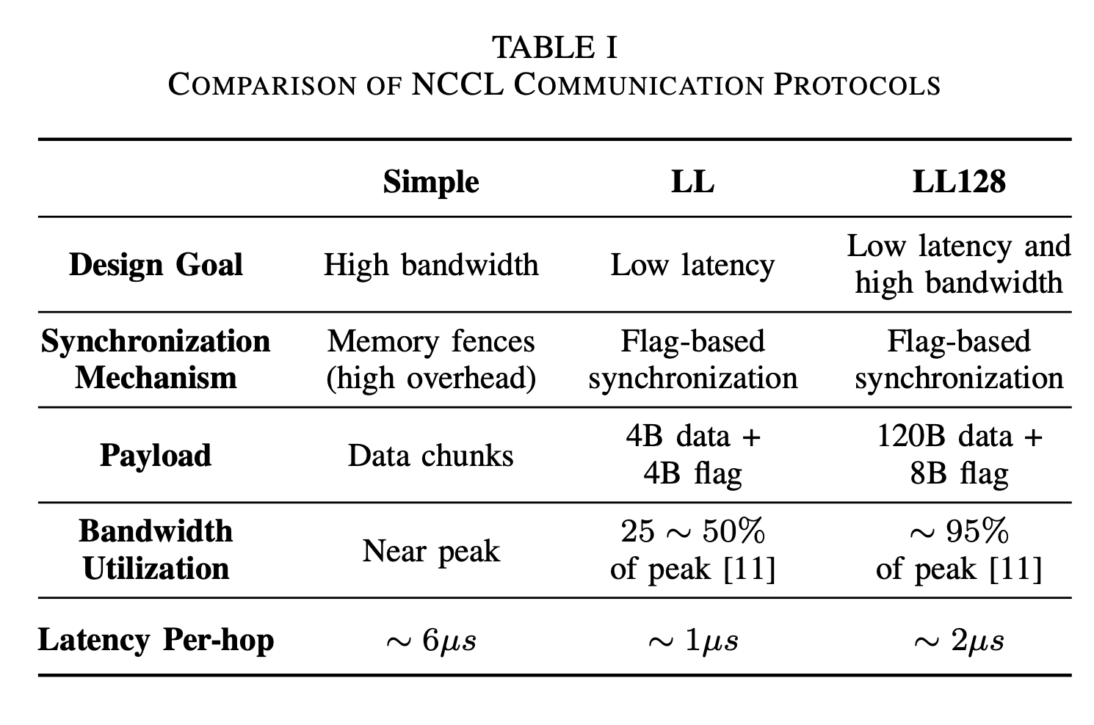
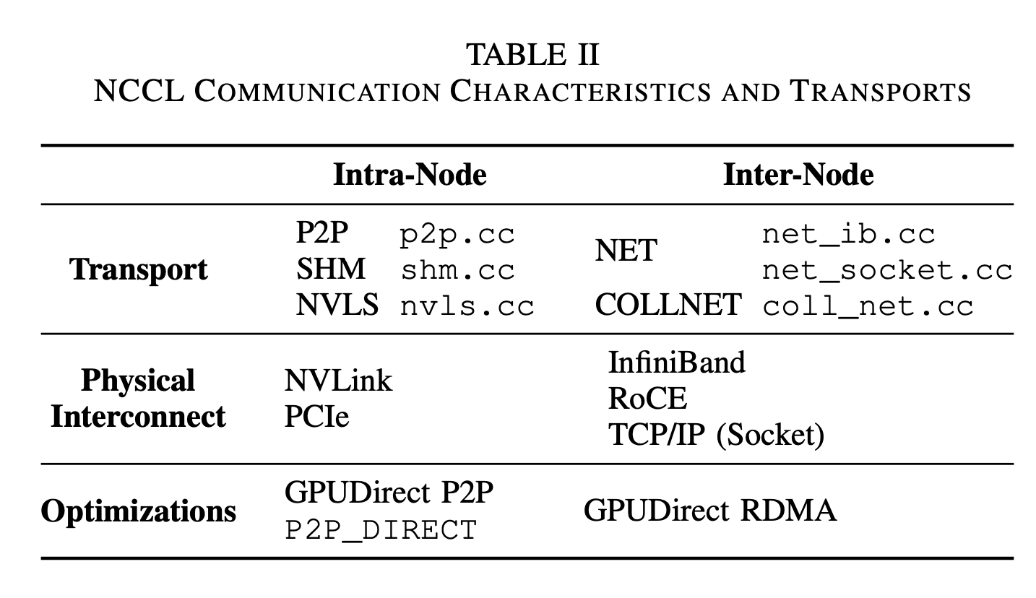
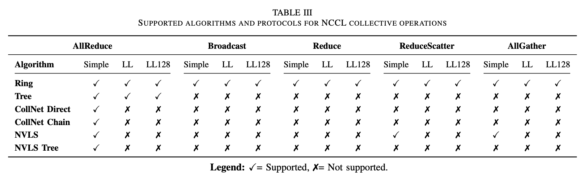
Besides, the protocol designs are also important
Take NCCL as an example.

Slide 21
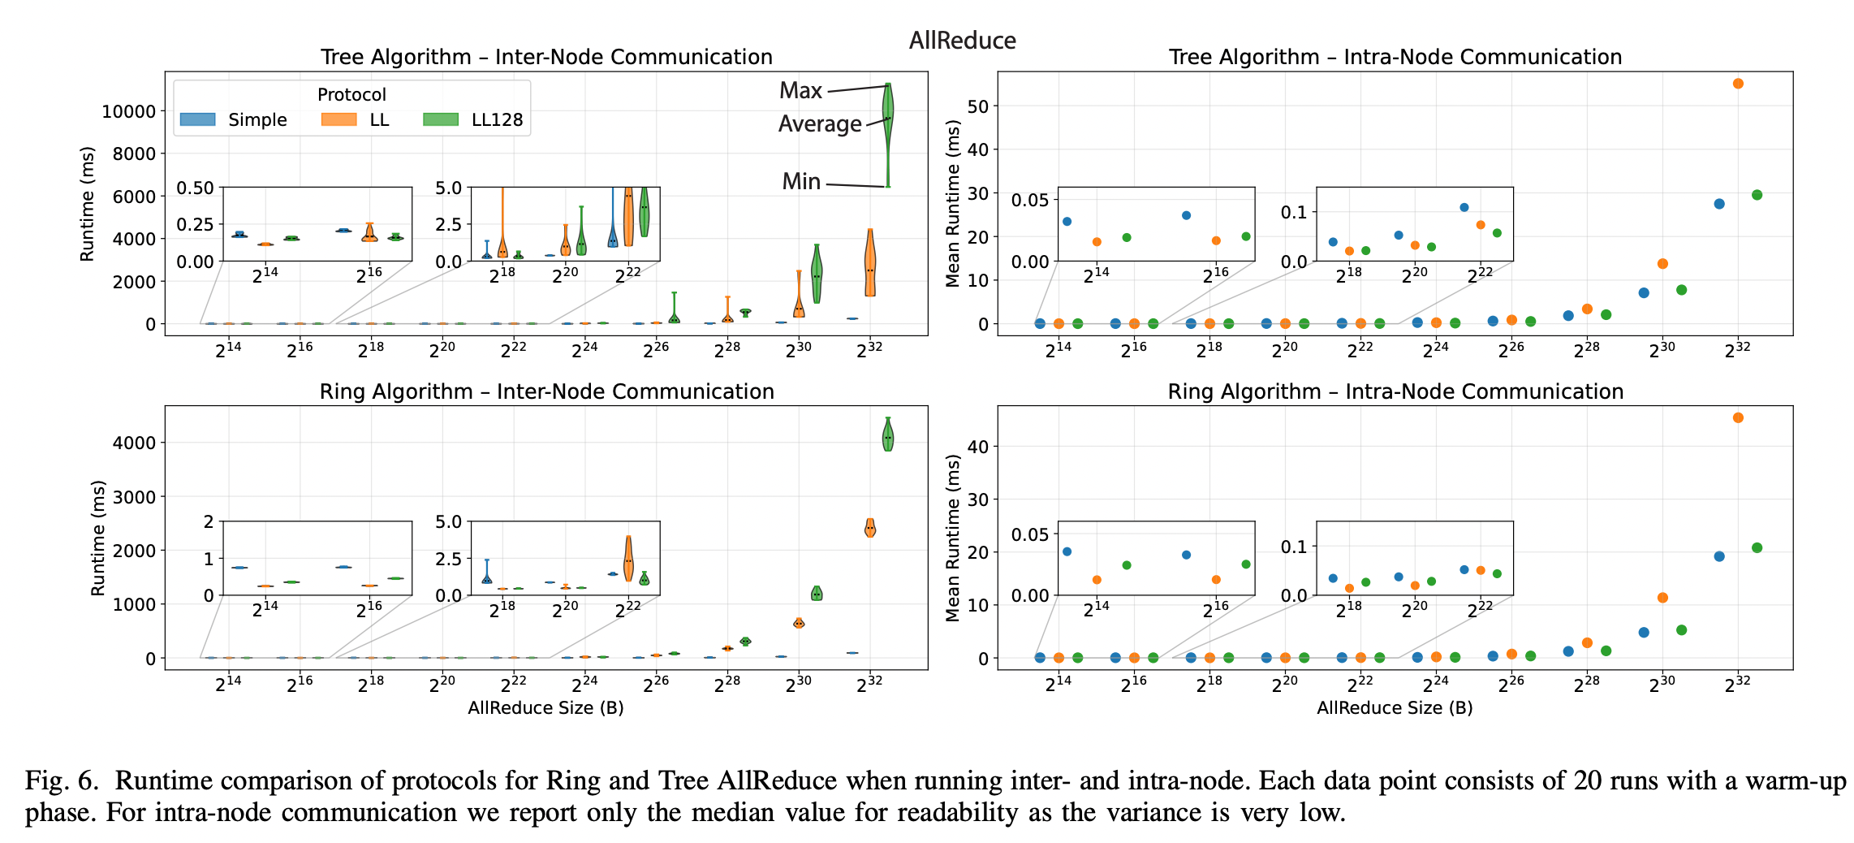
Besides, the protocol designs are also important
Take NCCL as an example.
Notes:
https://zhuanlan.zhihu.com/p/1976385706453652306

Slide 22

The Solution: FlagOS, a Unified AI Software Stack

Slide 23








https://space.bilibili.com/3546791834290849
https://github.com/flagos-ai
https://www.zhihu.com/people/95-22-20-18/posts
https://flagos.io/Home

Slide 24

Thanks for your time！

